Slide 1

Updates
Michelle Nienhius, MPH
Manager, Division of Prevention and Intervention Services
August 3, 2023
Notes:
Custom DAODAS color codes is : Red-0
Green-131
Blue-139

Slide 2
Topics Addressed:
FY24 Funding and Compliance Contract and Prevention Services Manual
GMS Projects for FY24
Grants Management System Reports
CTC Survey
Synar/STEP
PREP
TEP
Overdose Prevention
Training/Resources

Slide 3
FY24 Funding and Compliance Contract and Prevention Services Manual

Slide 4
FY 24 Funding and Compliance Contract and Prevention Services Manual
Contracts have been sent out via DocuSign
Prevention Directors should obtain a copy of the executed contract from the Executive Director to review
Prevention Services Manual has been updated for FY24 and the revised copy will be placed on the SC Documents website
Reminders:
All full- and part-time employees (or contract personnel providing direct service related to primary prevention services) delivering prevention services shall have a period of 36 months from their permanent date of hire to obtain prevention certification through the South Carolina Association of Prevention Professionals and Advocates. The certification timeline allows agencies to include a probationary period, not to exceed six months, if they desire.
All prevention professionals must have a training plan for obtaining and maintaining certification. This plan must be updated annually.
All prevention staff shall attend the Substance Abuse Prevention Specialist Training (SAPST) within two years of their hire date.

Slide 5
A key element for ensuring that the highest-quality prevention services are provided to all South Carolina citizens, organizations funded by DAODAS through the Substance Abuse Prevention and Treatment Block Grant (SABG) shall obtain and maintain national accreditation by either the Joint Commission or CARF International for their primary prevention programs that target children, youth/adolescents, and adults.
Each agency shall have at least one representative attend the Prevention Quarterly Meetings that are held by DAODAS on the first Thursday (unless notified of a change by DAODAS) of the following months: August, November, February, and May.
It is the responsibility of the agency to send to DAODAS a revised Prevention Staffing Capacity Plan if there are any personnel changes, staff funding changes, etc., that occur throughout the fiscal year.
Prevention providers are required to use the DAODAS Standard Survey (provided separately) as an evaluation tool for any multi-session education program aimed at youth ages 10 to 20. This applies to research-based and non-research-based programs. Program exceptions for the use of the DAODAS Standard Survey are noted and defined in the South Carolina Prevention Evaluation Handbook. There is a paper and online version of the survey available.

Slide 6
All prevention personnel funded through the SABG Primary Prevention Set-aside (regardless of percentage of salary funded) are required to enter direct and indirect service hours into the web-based reporting system each month. The percentage of staff time entered is expected to be direct/indirect service time in order to accomplish each agency’s goals/objectives that have been set for primary prevention. Each agency is required to complete the Prevention Staffing Capacity Plan and send to DAODAS by the end of July each year. It is the responsibility of the agency to send to DAODAS a revised Prevention Staffing Capacity Plan if there are any personnel changes, staff funding changes, etc., that occur throughout the fiscal year.
Each prevention staff member funded under the SABG Primary Prevention Set-aside shall enter data by the end of each week. However, minimal standards for timeliness are that all data must be entered monthly, with reporting complete by the eighth working day of the following month. If there is a need for an extension for data entry, a request shall be made by the agency to the DAODAS Manager of Prevention and Intervention Services at least five business days in advance of the deadline.

Slide 7
Minimum standards for accuracy of monthly data entered into the web-based reporting system are as follows:
a) correct application of service categories (direct vs. indirect) and populations served;
b) required monthly documentation of service hours for any organizational member or volunteer who is providing prevention services;
c) Demographics of people served in prevention services as required for federal reporting;
d) appropriate documentation of funding and reporting to ensure compliance.
**These are just a few highlights from the Manual, please read the entire document and contact DAODAS with any questions.

Slide 8
  Primary Prevention Funding Formula
A standard formula for the distribution of the SABG primary prevention set-aside funding was adopted by DAODAS in July 2013 and went into effect with state Fiscal Year 2014 (FY14).
Incorporating input from the Executive Committee of Behavioral Health Services Association of South Carolina Inc., the adopted allocation method was developed by DAODAS to achieve a base funding amount for each county, along with a population-adjusted figure to ensure that prevention services are provided equitably across the state.
Due to an overall increase in the allocation for South Carolina for the Substance Abuse Prevention and Treatment Block Grant (SAPT BG), from $23,934,835 in FY23 to $26,137,986 in FY24, the total for the 20% set aside for primary prevention also increased from $5,265,666 in FY23 to $5,619,667 in FY24.
FY24 Formula
1. The “floor” (base) will be increased to $70,000 for each county authority. (Changed from $60,000)
2. County authorities that serve more than one county receive an additional $15,000 per county. (remains same)
3. Revised population-based data from the 2020 Census. The percentages did not change from Fiscal Year 2023. These range from 0.40% to 13.87%. The funding range changed from $7,223.66 to $249,152.33 due to an increase in the funding allotted to this part of the funding formula and the population estimates. At a minimum, population adjustments will be revised every five years. (Increased from FY23)

Slide 9
Primary Prevention Funding Formula
Amounts for AET did not change from FY23 (Carry forward COVID-19 funding was provided for all 16 circuits at a level of up to $25,000 to spend on approved plan from July 1, 2023-January 31, 2024)
Based on the funding formula, all agencies received an increase between $10,000-$11,965.00
Questions- email Sharon Peterson (speterson@daodas.sc.gov ) and Michelle Nienhius (mnienhius@daodas.sc.gov )

Slide 10
Grants Management System
Project Set-up for FY24 and Reports

Slide 11
FY24 Primary Prevention Block Grant Projects are currently being created in GMS by DAODAS.
Early next week, Prevention Directors will receive an email with an Excel file attached to review to ensure all Goals, Objectives and Performance Measures intended to implement for the fiscal year are accurately reflected. DAODAS will ask that the information be reviewed ASAP and returned to DAODAS with any updates/corrections noted.
DAODAS will activate the projects (hopefully by the end of next week-August 11th) once GOPs are approved.
Data for July and August should be entered to correspond with the new project GOPs (SABG23-PR-ALL-AIK-20230701-20240630
All July and August reimbursement requests will be processed no later than the 8th working day of September if data entered reflects the request. It is our goal to be up and running for “real-time” data entry for services occurring in September and moving forward.
Please complete all fields (even the ones that are not labeled as required) to ensure that the integrity of the data is high. If you have a question related to data forms, please contact prevention@daodas.sc.gov to ensure accurate information is reported.

Slide 12
Steps for pulling data from Prevention Data Portal through GMS:
1. Bottom left-hand corner- Click on blue G-GrantVantage symbol and change view to DAODAS Portal (DP) view
2. On left-hand side, click on “Portal Submission”
3. On top right, click on “Edit Columns” to bring up a menu on right side.
4. Click “+ Add Columns” to add the following columns to the report: Form Name, Intervention Type, Total Duration Hours, Total Duration Minutes and Strategy to the report. You can add the columns by typing the heading in the search bar (Form Name) and then select the heading and click “close”. This will then take you back to the list. Repeat the steps to continue to add each one until you have all of the additional columns added to the list.
5. Click “blue apply” button and this will return you to the Portal Submission view-now it will have the additional columns you added in visible as you scroll to the right.
6. Click on arrow beside “County of Operation” then “Filter By” to bring a drop down menu where you can type in all of the counties you want to view (one or more). This will filter the view to only show the data for the counties you want to view. Click “Apply” once you have selected the county or counties you want to view.

Slide 13
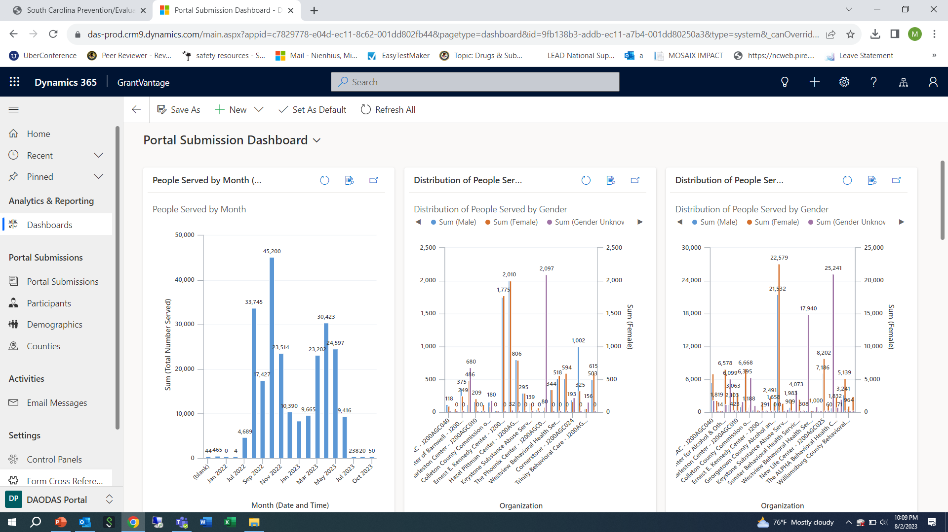

Slide 14
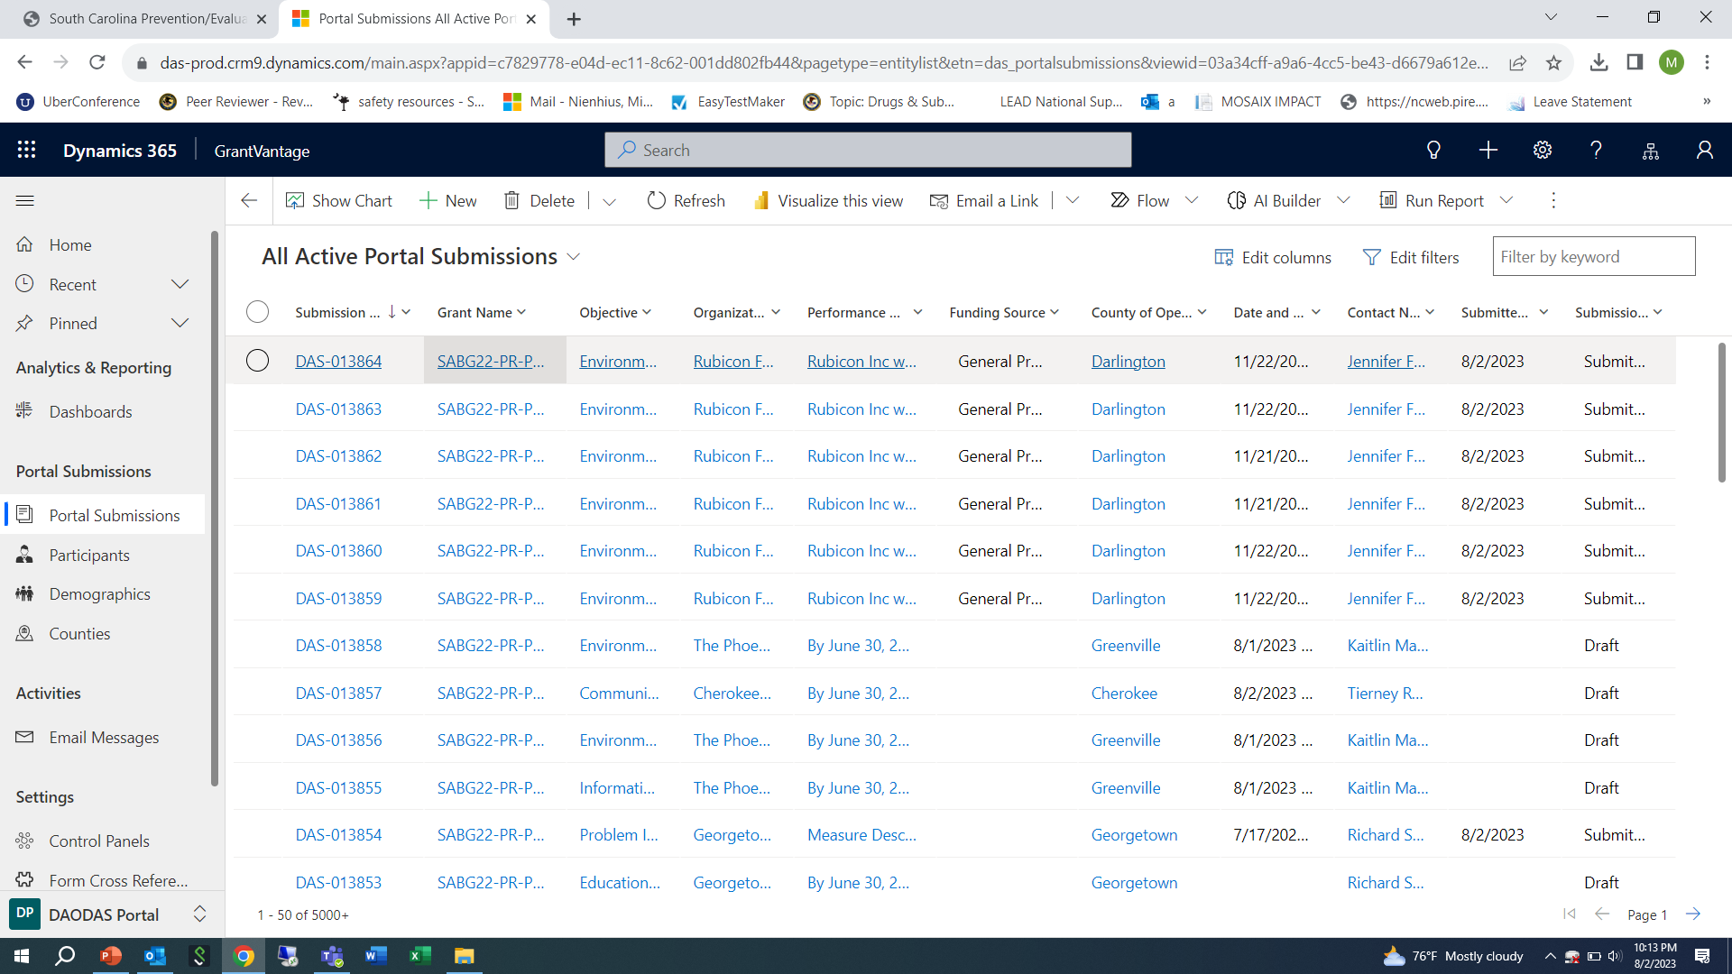

Slide 15
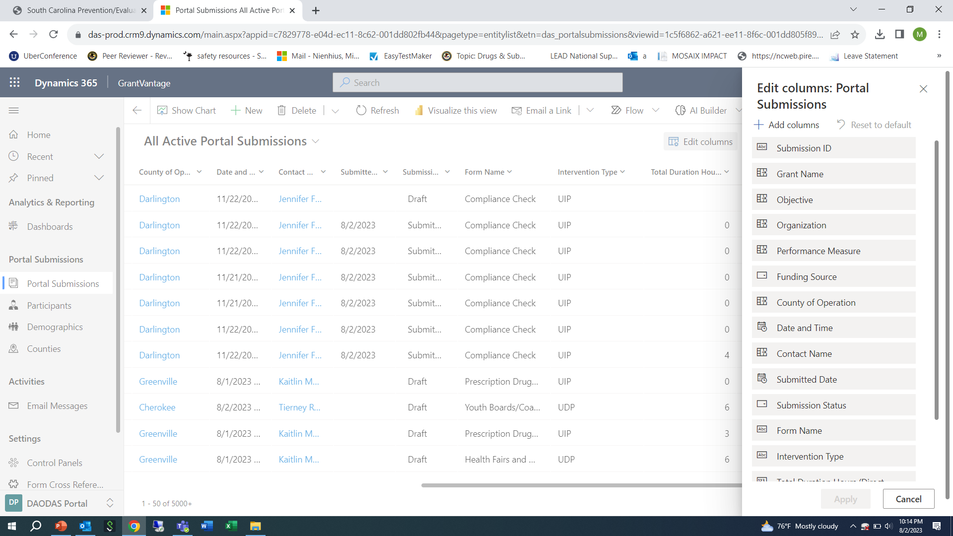

Slide 16
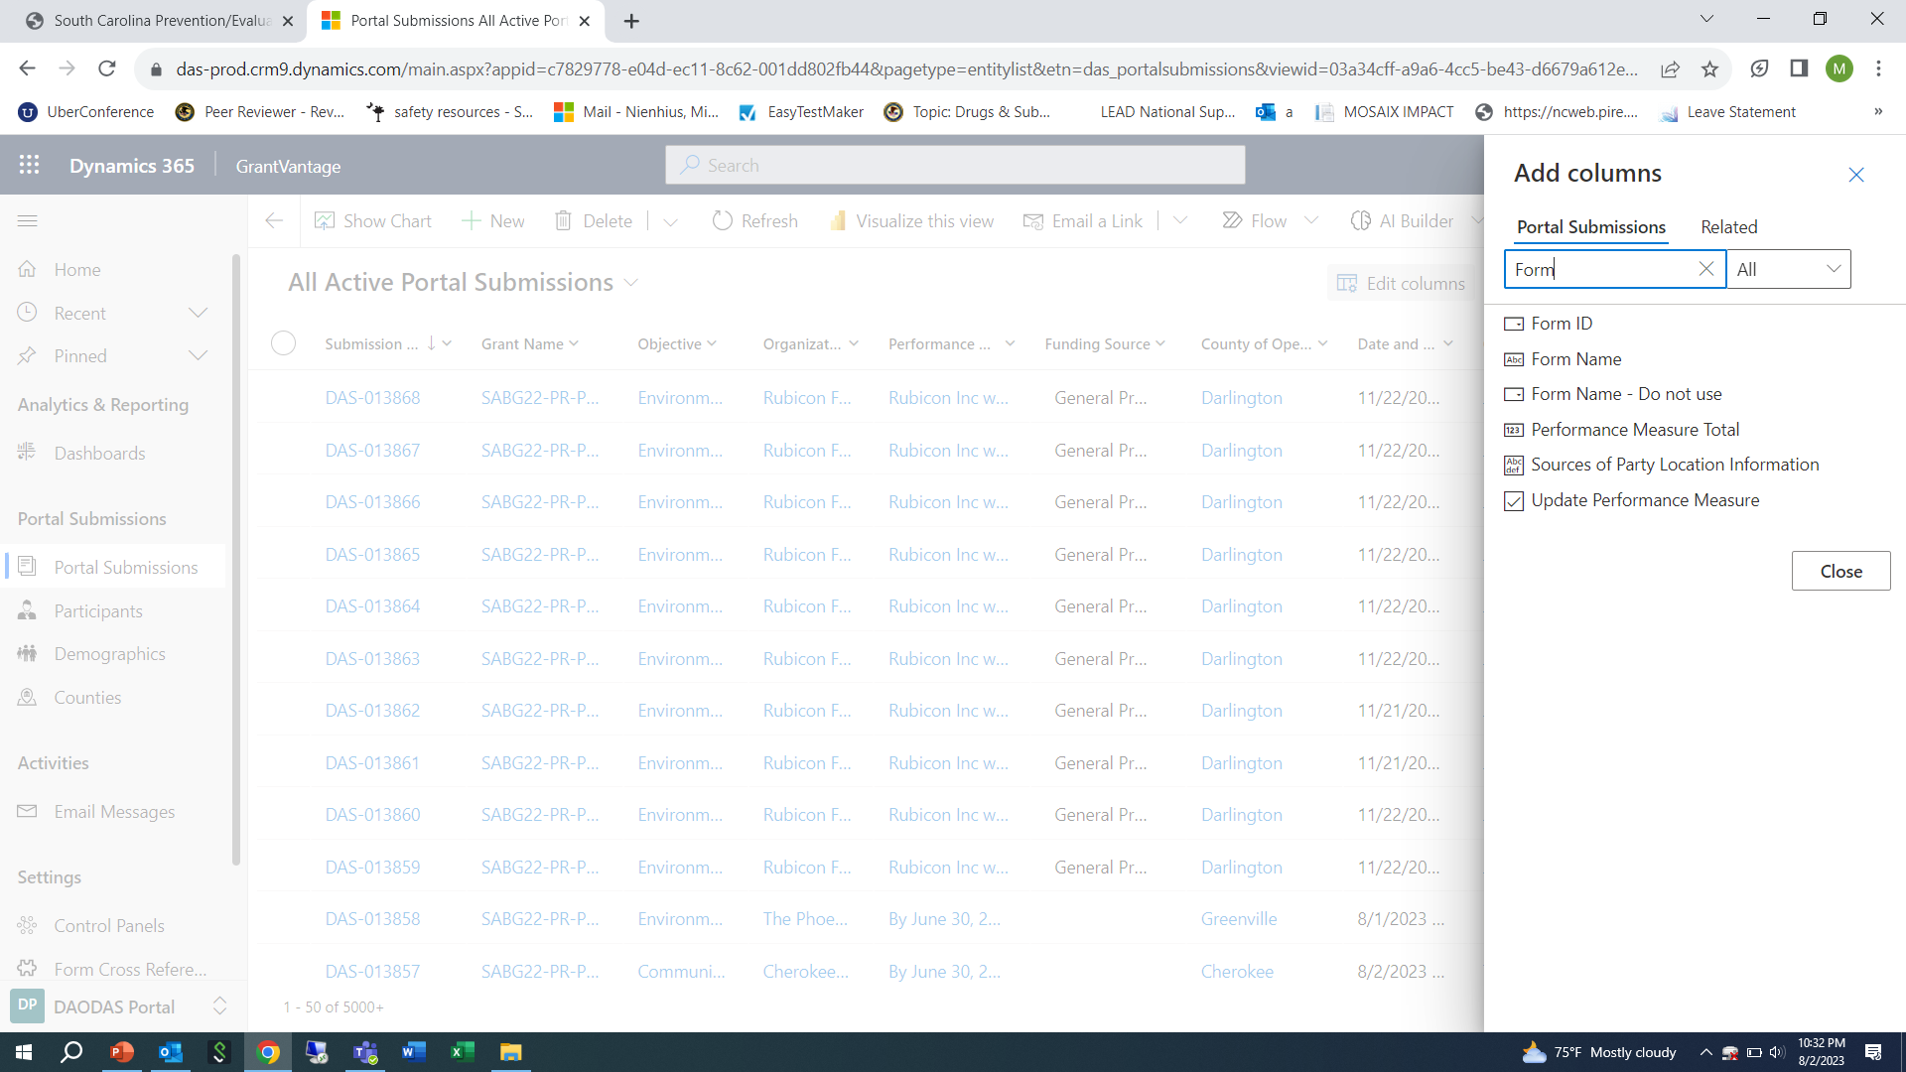

Slide 17
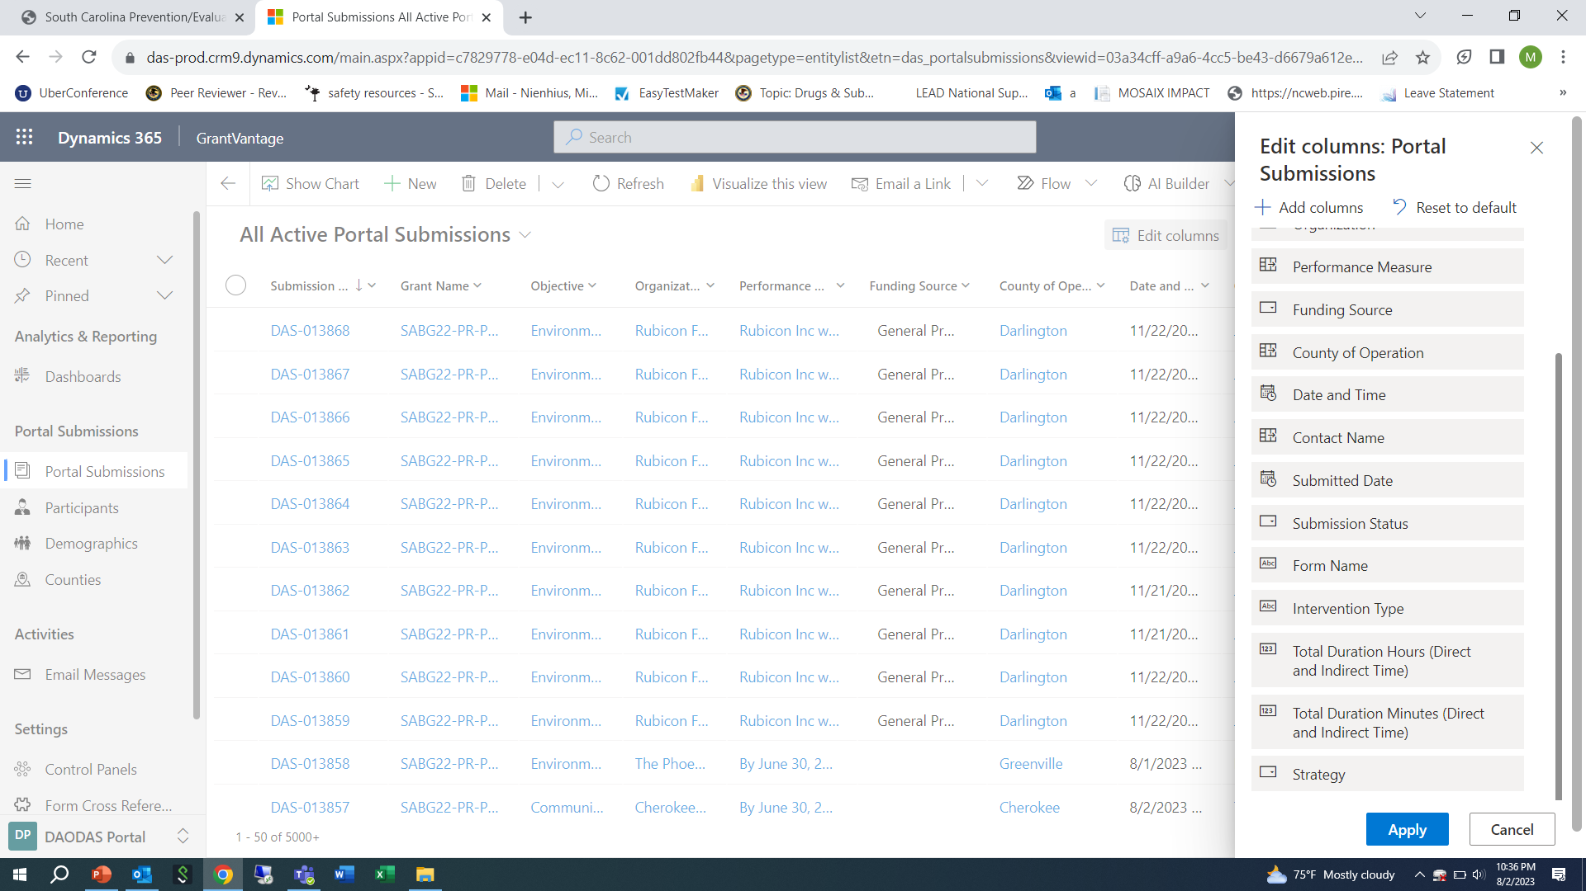

Slide 18
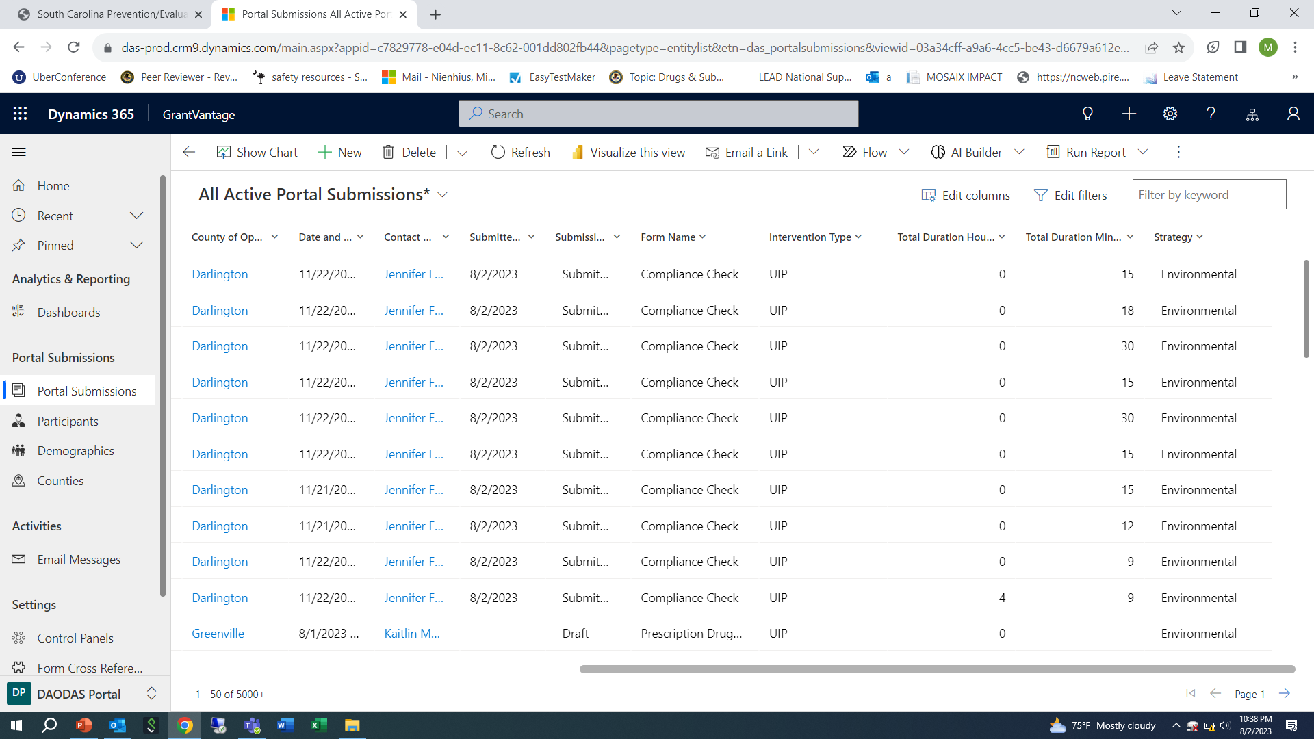

Slide 19
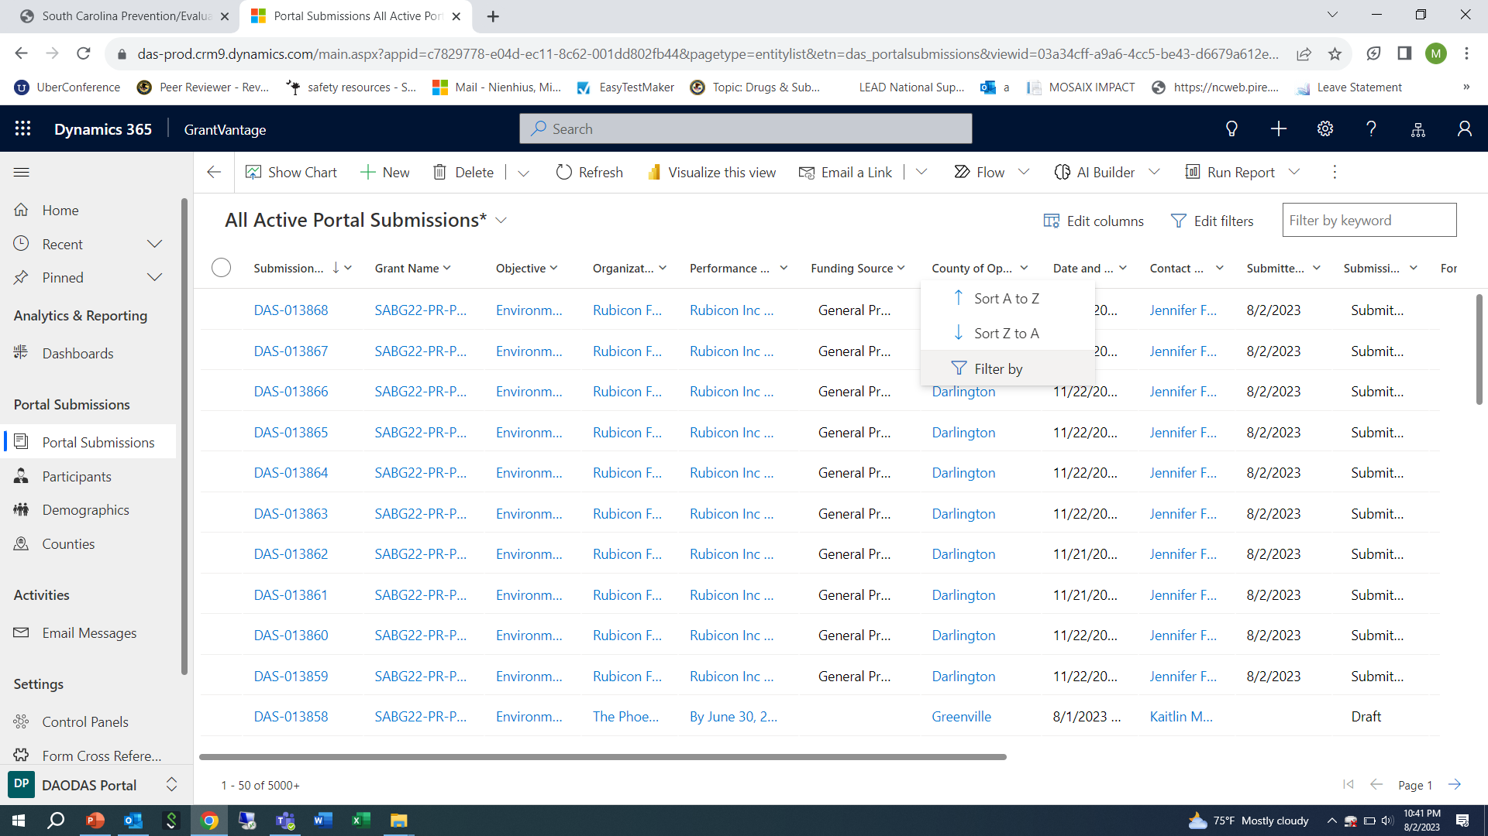

Slide 20
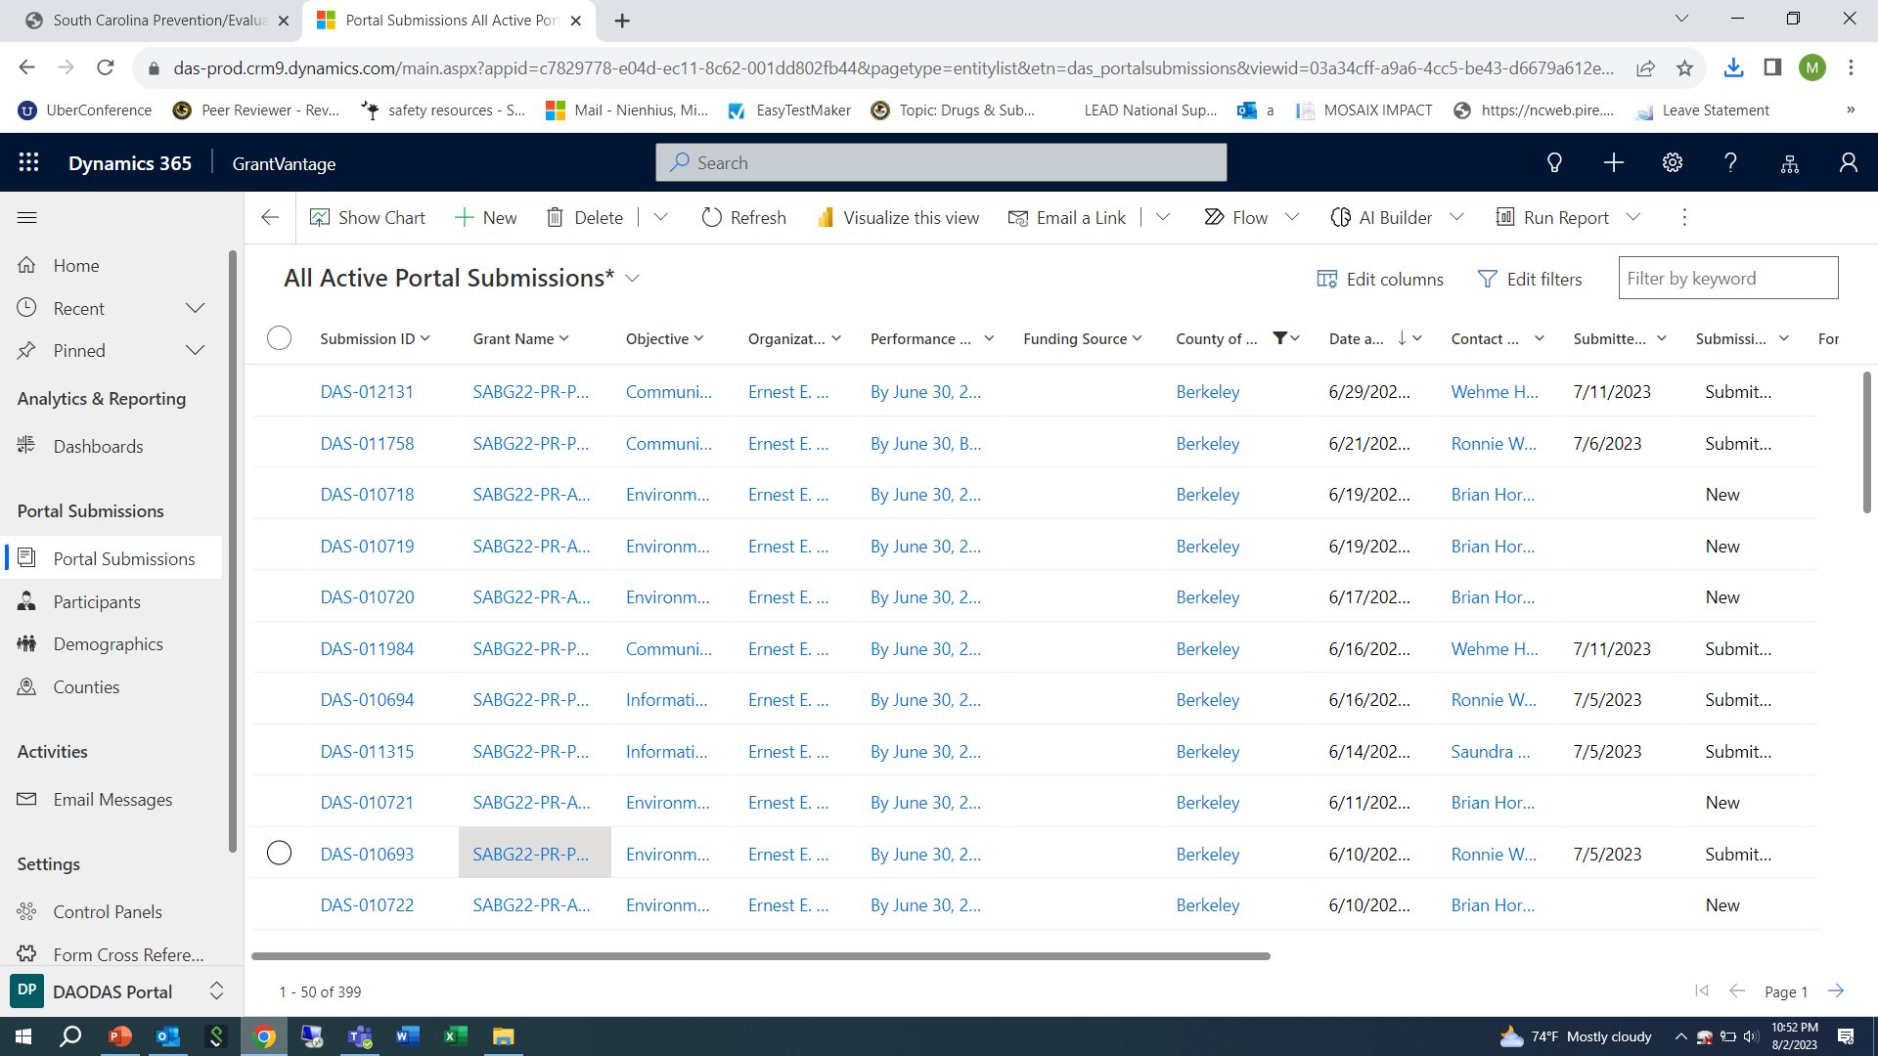

Slide 21
7. Click on 3 dots on top right to bring up the option to download the data into an Excel file
8. Click “Export to Excel”. The file will download into your “downloads” folder.
9. Once the data is in Excel, you can work with the data and filter the information in many different ways. The Excel report can be shared with agency leadership as needed, finance to demonstrate services provided (or forms that are in draft) for monthly reimbursement requests, etc.
10. You can also just apply various filters and remove them as needed if you are only needing a “quick” view of information.
Contact DAODAS with any questions or technical assistance requests. We can walk you through this step-by-step as needed via TEAMS/ZOOM. (prevention@daodas.sc.gov )

Slide 22
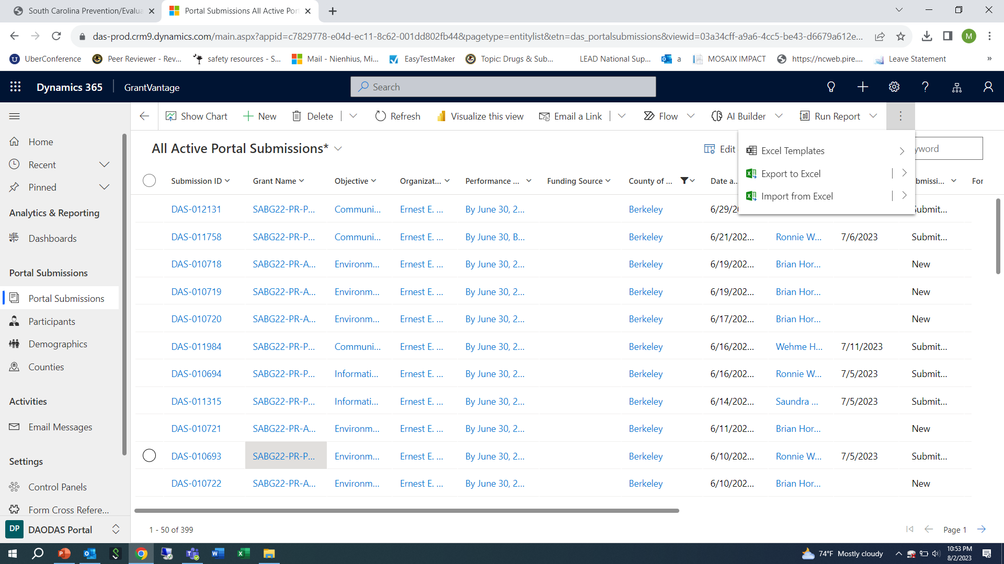

Slide 23
Formatted “Canned” Reports Available in GMS:
Way Path is working on additional “canned” reports, however there are some available to view at this time.
Reports available include:
  Compliance Checks
  Individual-based programs and strategies
  Population-based programs and strategies
  Single services by demographics
  Number of media impressions
  Number of persons served by individual or population-based programs and strategies
  Distribution of people served by gender
  Distribution of people served by age
  People served in 12-month period
  Prevention Strategy Report is only available to DAODAS at this time
To access: Click on “reports” on bottom left of menu

Slide 24
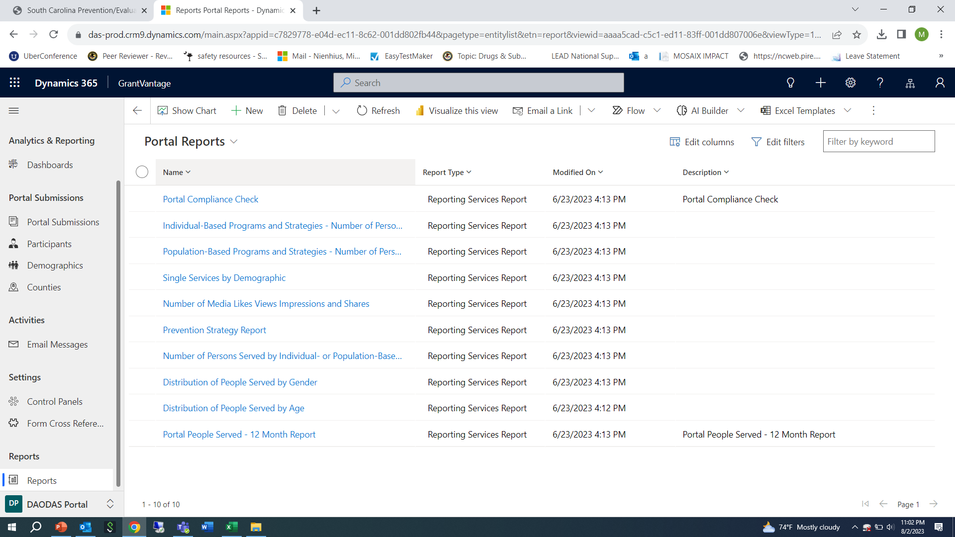

Slide 25
Choose report you want to view
When template comes up, complete the fields as suggested below:
Year: 2022
Reporting Period: SC State fiscal year July 1-June 30
Strategy: Select All (you can also narrow down by only one strategy at a time)
Intervention Type: Select All (or if you are choosing one strategy, be sure to select the right intervention type for the strategy selected)
Counties: Can choose one or multiple counties to view
Forms: Select All
Organizations: Select organization that matches the county or counties of service selected
Click “View Report”
Click on “save” icon to download report to PDF that can be provided to leadership or other partners
Contact DAODAS with any questions or technical assistance requests. We can walk you through this step-by-step as needed via TEAMS/ZOOM. (prevention@daodas.sc.gov )

Slide 26
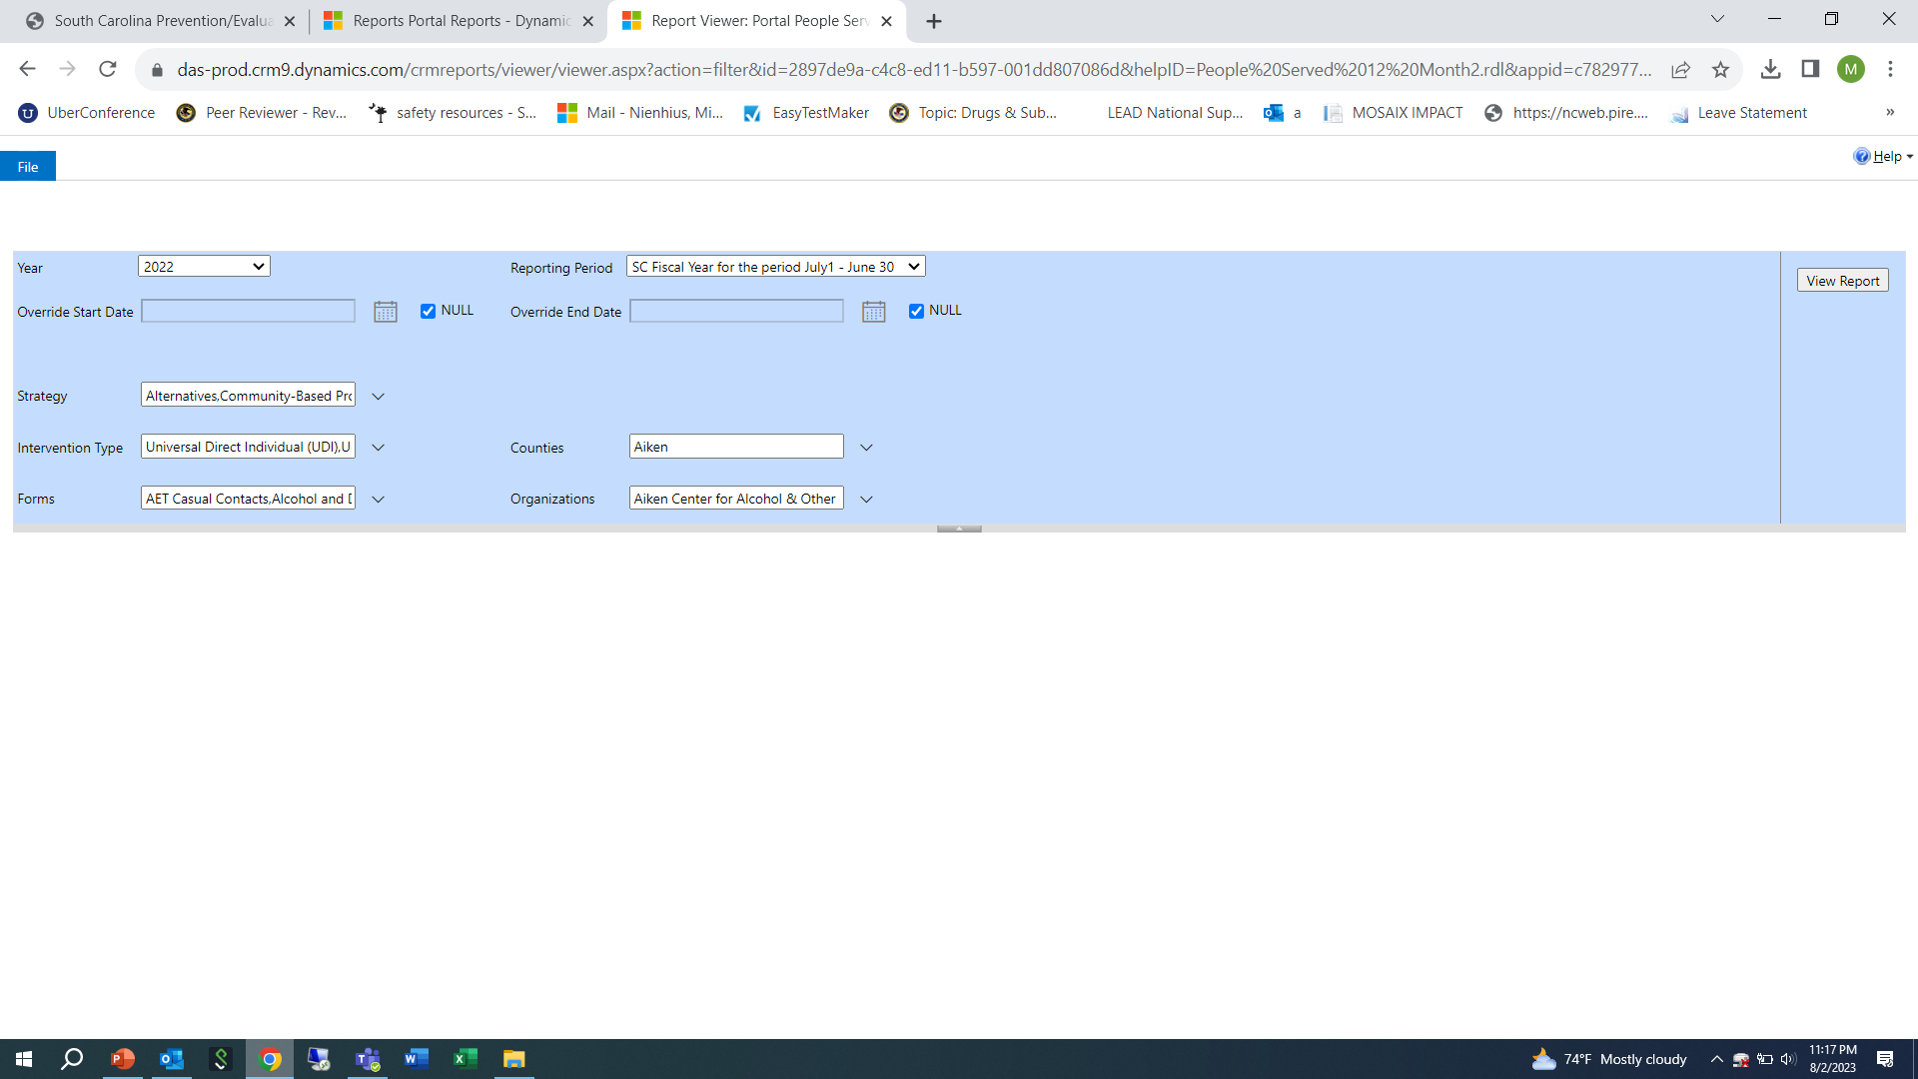

Slide 27
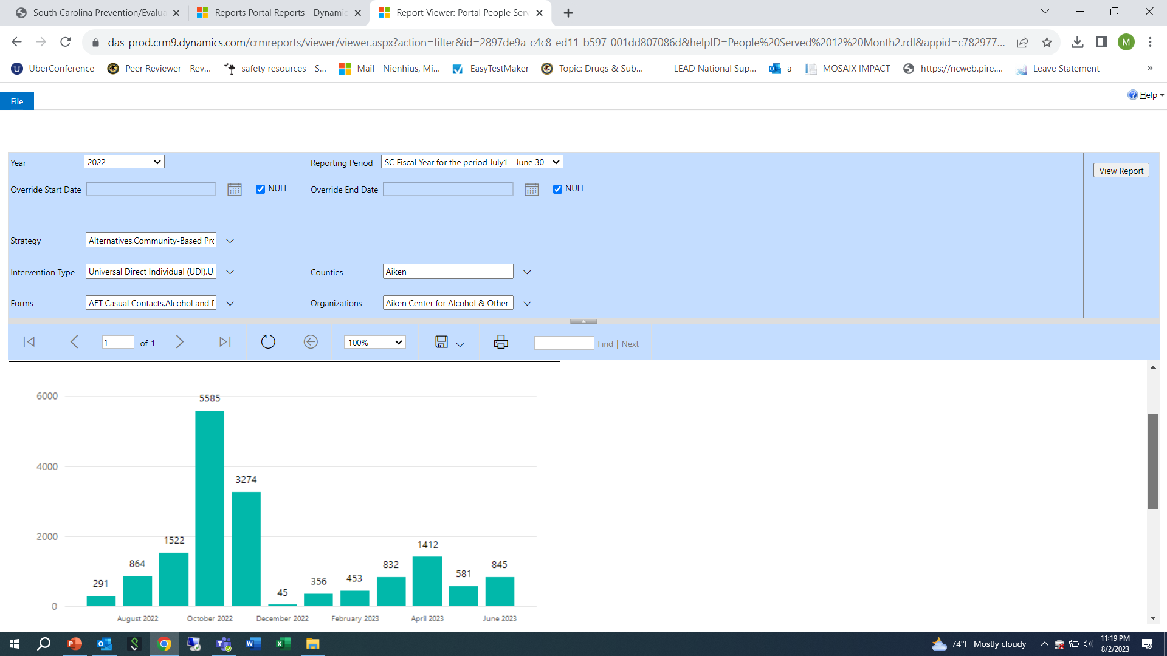

Slide 28
Communities That Care Survey
Timeline and Reminders

Slide 29

South Carolina Department of Alcohol and Other Drug Abuse Services
Overview of CTC Survey
SC CTC Survey administration dates are January 22 – March 25, 2024.
Schools will have the opportunity to add up to four locally determined questions to their survey.
  Additional questions must be submitted to DAODAS by November 17, 2023
Training and technical assistance will be available.
DAODAS will be the sole fiscal agent of the 2024 SC CTC Survey, and will issue payment to the survey vendor for survey administration.

Slide 30
South Carolina Department of Alcohol and Other Drug Abuse Services
Overview of CTC Survey
The number of schools that are recommended to participate depends on the size of the district. School districts with:
  1-3 schools must administer the survey in at least 1 school.
  4-6 must administer the survey in at least 3.
  7-9 must administer the survey in at least 5.
  10-12 must administer the survey in at least 6.
  more than 12 HS must administer the survey in at least 8.

Slide 31
South Carolina Department of Alcohol and Other Drug Abuse Services
CTC Survey Administration & Plan
Simplest Approach - Survey entire middle and high school student body.
  Otherwise, recommendation is to survey at least 7th, 9th and 11th grade students.
Sites are encouraged to go beyond their 2022 sampling plan (those who conducted CTC previously) to include more schools and grades when possible.
At minimum, surveying the same schools and grades that they did in 2022 would ensure stronger data comparisons.

Slide 32
Timeline
South Carolina Department of Alcohol and Other Drug Abuse Services
June 30, 2023
Wave 1: Survey recruitment at local level-confirm participation with DAODAS
June 16- August 3, 2023
DAODAS provides County Alcohol and Drug prevention staff the new draft survey to review with school officials. Feedback to DAODAS by August 3
October 31, 2023
Wave 2: Survey recruitment at local level-confirm participation with DAODAS
November 17, 2023
December 4-8, 2023
Additional questions to be added to school-specific surveys
Initial Survey administration instructional training

Slide 33
Timeline
South Carolina Department of Alcohol and Other Drug Abuse Services
January 8-12, 2024
Final/follow-up survey administration instructional training
January 12, 2024
All survey administration instructions e-mailed to named contact in each county.
January 22-March 15, 2024
Survey administered to students.
April-May 2024
May 2, 2024
Quality Control and analytic period
Highlights from State report provided at May Prevention Quarterly Meeting

Slide 34
South Carolina Department of Alcohol and Other Drug Abuse Services
Contact Information
Who to contact for more information
  Michelle Nienhius, Prevention Division Director at mnienhius@daodas.sc.gov
  Emma Zawacki, Epidemiologist
  ezawacki@daodas.sc.gov
  Recruitment materials are on SC Documents website: https://ncweb.pire.org/scdocuments/
  Search: Prevention Quarterly Meeting Materials (May 4, 2023)

Slide 35
Synar/STEP

Slide 36
SYNAR and STEP Program Overview
Synar Tobacco Enforcement Partnerships (STEP)
The SC STEP program is an incentives based program that incorporates current aspects of our state’s prevention system, the Synar study, merchant education, and mandated county tobacco compliance checks, with federal mandates and other tobacco control and enforcement initiatives, the Synar coverage study (federal requirement) and tobacco strategy incentives. (i.e., Tobacco Education Program, Point-of-Sale work, and Multi-Jurisdictional Law Enforcement Agreements).
The intent is for the STEP program to package tobacco enforcement best practices and requirements and provide financial incentives to encourage the use of best practices at the local level.
Each year, a portion of the Substance Abuse Block Grant (after the costs are reimbursed for the Synar study and bonuses) is divvied up and allocated based on the STEP-approved activities completed in each county.
Payments for this past fiscal year were issued in early July.

Slide 37
SYNAR and STEP Program Overview
Counties can earn STEP points for some or all of the following efforts:
• Conducting tobacco compliance checks,
• Reporting new tobacco outlets and cleaning their list frame,
• Merchant Education,
• Tobacco Education Program,
• Point-of-Sale Taskforce development,
• Merchant Pledge(s),
• Establishing multi-jurisdictional law enforcement agreements around tobacco.
Please use the following designated STEP email address to ask DAODAS questions regarding STEP: daodas.stepprogram@daodas.sc.gov
Additionally, all templates, forms, and the STEP Cover Sheet are on the SC Documents webpage:
Search STEP

Slide 38
PREP/TEP

Slide 39
PREP Reminders
Revisions have been made to the PREP curriculum
All materials are on DAODAS website: https://www.daodas.sc.gov/services/prevention/merchant-initiatives/
PREP Training Materials- this is a password protected site
Password will be provided via email once staff members complete TOT
TOT training on Relias: The video can be found under the following title and individuals can self-enroll South Carolina Palmetto Retailers Education Program Training of Trainers 2022 (PREP TOT)
Please use the new fillable forms-all names and addresses should be typed into the new forms-handwriting is difficult to read and postage is being wasted when cards are returned to the agency.

Slide 40
Overdose Prevention

Slide 41
Suspected opioid overdose events were identified from EMS response using a case definition based on diagnoses, naloxone administered, and keywords, which may
be different from a raw count of naloxone administrations. This data does not include non-fatal overdoses where individual went directly to hospital or fatal overdoses
without EMS involvement. Data is deduplicated to remove multiple entries for different agencies responding to the same incident.
Overdose data from the South Carolina Department of Health and Environmental Control, Bureau of EMS and Trauma. Population estimates for county rate calculations
from 2020 Census Redistricting file.
Data is preliminary and subject to change. Published July 21, 2023.

Slide 42
Situational update on suspected opioid overdoses from EMS data in South Carolina for June 2023
Total incidents were 1% lower than the previous month and 6% lower than the same month last year
Trends to note and possible areas for focus:
Five of the state’s High Intensity Drug Trafficking Area (HIDTA) counties (Greenville, Horry, Charleston, Lexington, and Richland) were in the top 10 counties by number of suspected opioid overdoses, and Horry and Lexington were in the top 10 for opioid overdose rate in June 2023
Of the counties in the top 10 for rate per population, Cherokee experienced a 128% increase in the rate of suspected opioid overdoses over the prior month. Lancaster, Fairfield, Greenwood, and Lexington experienced between a 33% and 40% increase in the rate of suspected opioid overdoses over the prior month
Several counties have sustained high rates of opioid overdoses for several months:
  Horry: top 10 for opioid overdose rate since April 2022.
  Dillon: top 10 for opioid overdose rate since November 2022, except for June 2023.
  Union: top 10 for opioid overdose rate since December 2022.
  Jasper: top 10 for opioid overdose rate 8 times since September 2022.
  Chester: top 10 for opioid overdose rate since March 2023.

Slide 46

National Fentanyl Prevention and Awareness Day: August 21, 2023
https://facingfentanylnow.org/
WHY AUGUST 21? National Fentanyl Prevention and Awareness Day™ is August 21. The date is chosen not to overshadow the importance of Overdose Awareness Day that falls in the same month, but as a perfect time to bring attention to the differences between "overdose" and poisoning.
August 21st is a coordinated day of response by grassroots fentanyl awareness organizations and families impacted by fentanyl to educate the public about the dangers of illicit fentanyl. DEA is proud to work with families who have been affected by fentanyl poisonings to spread the word and save lives.
#facingfentanylnow
Learn more about the danger of illicit fentanyl at https://facingfentanylnow.org or www.dea.gov/onepill.

Slide 47
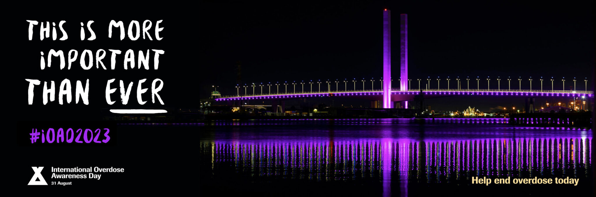
International Overdose Awareness Day: August 31st
https://www.overdoseday.com/

Slide 48
Training/Resources

Slide 49
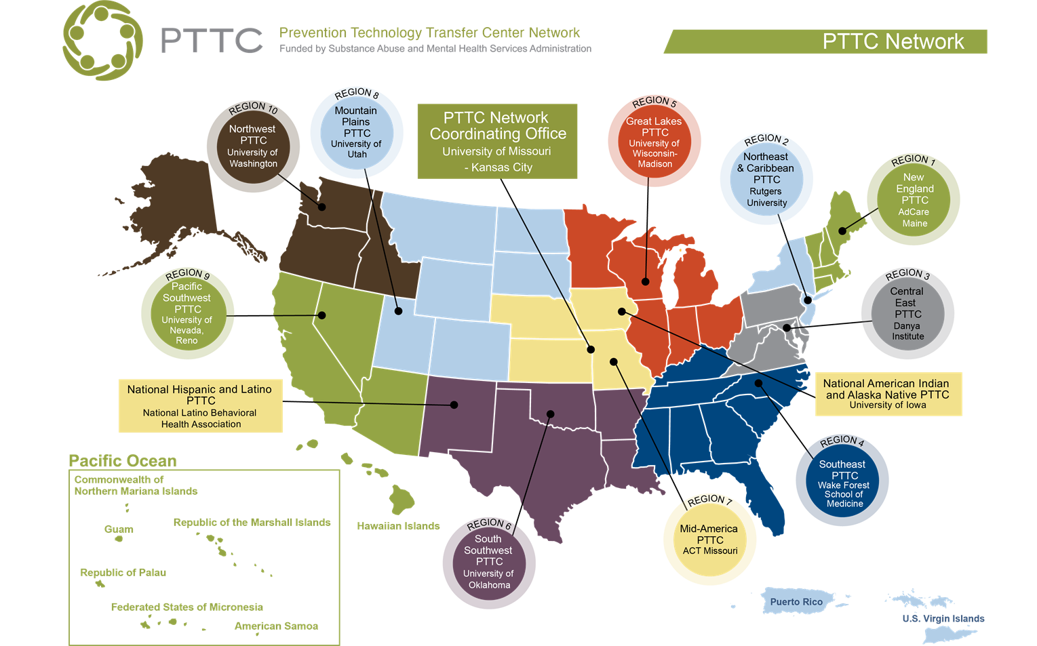
The purpose of the Prevention Technology Transfer Center (PTTC) Network is to improve implementation and delivery of effective substance use prevention interventions, and provide training and technical assistance services to the substance misuse prevention field.

Slide 50

Free Online Learning & Low-Cost Continuing Education for Health and Behavioral Health Professionals
Create an account and begin accessing courses
https://healtheknowledge.org/
The following slides are just a sampling of the many courses available on the website-login to discover these and many more!
https://healtheknowledge.org/course/index.php?categoryid=89

Slide 51
Prevention Specialist Performance Domains
The success of prevention efforts in the community is dependent on a competent, well-trained, ethical and professional Prevention Specialist. Therefore, the purpose of this 3 hour training program is to enhance the quality of services provided as well as the knowledge and skills necessary to become a Certified Prevention Specialist (CPS).
The Social Determinants of Health
The aspects of life that influence a person’s health, including their likelihood of engaging in risky behavior such as substance use, are numerous and varied. They range from very immediate, personal characteristics to overarching societal trends and conditions. The social determinants of health are these larger social or environmental aspects that influence us, such as the economic status of the neighborhoods in which we live, our access to quality health care services, and the amount of discrimination we face. This three-part, 3 hour, self-paced course will provide a comprehensive overview of the social determinants of health and examine the influence they have on substance use. It will also discuss the impacts a public health approach can have on them, review how to turn prevention knowledge into actionable processes, and provide recommendations on how to address them through the principles of prevention science and using environmental and other strategies.

Slide 52
Introduction to the Prevention Core Competencies
The Introduction to Prevention Core Competencies for Prevention Professionals was designed to introduce practitioners to the essential competencies, knowledge, and skill to work in substance use and misuse prevention. It is based on the Prevention Core Competencies published by the Substance Abuse and Mental Health Services Administration (SAMHSA). The course provides a foundation for service delivery based on prevention science and the use of evidence-based practices. It strengthens the understanding of effective planning and implementation approaches and encourages the pursuit of more specialized training and professional development.
1.Describe the key elements of prevention planning and evaluation.
2.Understand the core prevention professional knowledge, skills, and competencies.
3.Acknowledge the importance of research-based theories and processes that help explain and build effective prevention interventions.
4.Describe how evidence-based (EB) prevention strategies can be delivered across settings including the family, school, media, community, or workplace.

Slide 53
Upcoming Trainings:
August 9th: Alcohol Enforcement Teams: Statewide Comprehensive Training
August 9 @ 9:00 am - 5:00 pm at LRADAC in Columbia FREE-lunch will be provided
Registration closes tomorrow (August 4th)
SAPST Training in Columbia. Registration will open in September for October training:
October 2-5, 2023
March 4-7, 2024
Prevention Ethics Refresher (virtual for those who are already certified):
September 18, 2023 (registration will open mid-August) and February 14, 2024
Prevention Ethics Basic in Columbia
November 28-29, 2023 and May 7-8, 2024
https://www.daodas.sc.gov/education/upcoming-training
/

Slide 54

The purpose of the NPN Conference is to highlight the latest research in the substance use prevention field. It provides a forum for prevention professionals, coalition leaders, researchers, and federal partners to share research, best practices and promising evaluation results for the purpose of integrating research into prevention practice.
NPN Conference 2023
August 15 - 17, 2023
Sheraton Birmingham
Birmingham, Alabama
http://npnconference.org

Slide 55


2023 NLLEA Annual Conference
October 9-11, 2023
https://www.nllea.org/home

Slide 56

NOVEMBER 8TH & NOVEMBER 9TH, 2023
Historic Charleston, South Carolina
The 2nd Annual National Emerging Drug Trends Conference will be held on November 8th and 9th, 2023 in historic Charleston, South Carolina. The conference is an exclusive drug education and enforcement conference highlighting an array of superior speakers with expert knowledge.
REGISTRATION
https://www.emergingdrugtrends.com/about
SAVE
T H E
DATE

Slide 57
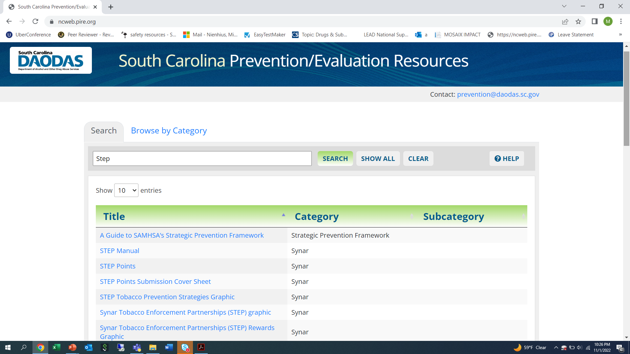

Slide 58

1801 Main Street, 4th Floor • Columbia, South Carolina 29201
telephone: 803-896-5555 • fax: 803-896-5558
www.daodas.sc.gov
Notes:
Final Slide

